Slide 1
Change log New pptx version for 1420
New chapter/slide
Changes on slide
Notes on slide
Update change log
Add text/changes in green
Delete text in red
Add note to the slide
Update change log
Add note to the slide
Notes in green box
Changes for 1420
Update change log
Add note to the slide
New slide for 1420
Changes for 1420
e.g. layout
Status | Chapter | Titel of slide | What is new | Responsible | Deadline | Comment
open | 14 (new) | PO change workflow (process update) | new chapter/slide | Ajit/Cristina | July 31st
open | 6 | PO reviewer BTP (form update) | notes on slide (layout) | Ajit/Cristina | Aug 29th
open | 2,3,4,6,8, 10, 11 | Email notification (cosmetic changes) | notes on slide (layout) | Ajit/Cristina | Aug 29th
 |  |  | new chapter/slide changes on slide notes on slide
 |  |  | new chapter/slide changes on slide notes on slide
 |  |  | new chapter/slide changes on slide notes on slide

Slide 2
MM081 Procurement via Direct X
SHERPA X GF
Notes:
Naming convention for course ID:
Digit1 and 2: SAP Module
Digit 3-5: consecutive numbering in steps of 10
Course titel should indicate the content / should be kept short

Slide 3


Ground Rules
Please consider the following guidelines during the training session
Turn your cell phone to silent mode.
Please do not access your email or the internet outside the breaks.
Please mute your microphone.
Participate fully in the training session and ask questions.
Respect each other`s contributions.
Notes:
You should add measurable objectives, such as explain, post.
Do not use „understand“.

Slide 4
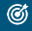
Course objectives
Upon completion of this course, you will be able to:
explain the Direct X procurement process
create purchase order workflow
review and approve the purchase order as a procurement expert
manage the purchase order output and send the purchase order to supplier
analyze the purchase order
Notes:
You should add measurable objectives, such as explain, post.
Do not use „understand“.

Slide 5
Prerequisites and Target Group
Prerequisites
BT020 SAP Fiori introduction and navigation
Target Group
Purchaser
Buyer
Procurement expert
Notes:
Target group: user roles, no SAP authorization roles

Slide 6
Agenda
1. Introduction & Process Overview
2. Purchase Requisition Process
3. PR - Assign Individual Purchaser Group - Buyer
4. PR - Purchaser Confirmation - Purchaser
5. Purchase Order Process
6. Purchase Order Creation
7. Adding Attachment to Purchase Order
8. Procurement Expert Selection
9. Confirm the Purchaser Order
Page 6
Notes:
Delete agenda item boxes which are not used.

Slide 7
Agenda
10. Expert Approval
11. Release Purchase Order - SAT Approval
12. Release Statuses
13. Purchase Order Output
Page 7
Notes:
Delete agenda item boxes which are not used.

Slide 8
1. Introduction & Process Overview

Slide 9
Introduction
Direct X is the Procure-2-Receipt (P2R) template in SAP S/4HANA for direct procurement referring to projects and services for Real Estate and Software Engineering.
The P2R process starts in SAP S/4HANA system with the creation of the purchase requisition and completes with the generation and issuing of the purchase order.
SAP Business Technology Platform (BTP) is an additional technology suite on top of SAP S/4HANA which manages workflows for the purchase requisition and purchase order.

Slide 10
Process Overview
Start (S/4HANA)
Requisitioner
Create PR in SAP S/4HANA & Review the PR details in BTP
Via OCI Punchout only
myMall
Buyer
Assign PR to individual Purchaser
Procurement Expert
Procurement Expert confirms PO
Is PR complete?
Finalize PR
Create PO
Purchaser reviews the PO
Yes
Purchaser
Is PO >50k€?
No
No
Yes
Approve PO - SAT
(max. 2 levels)
(Commercial,
Technical)
Send PO to Supplier via Print/EDI/Email
Supplier
Approver
PO response

Slide 11
Organizational and Technical Data for Pilot ARE 426Q/3003
P2R Roles
Requisitioner: Responsible for processing purchase requisitions (PR). Special OCI role based on country, company code & purchasing organization combination.
Organization Data
Purchasing Organization:
Technical Details
Document Types in S4P:
PO Output Medium
Buyer: Executes buying activities, such as retrieving quotes from suppliers and determining sources.
Procurement Expert: Validates and updates data in PO for specific use cases.
Purchaser: Handles PR processing and creates purchase orders (PO), order confirmations, and claims / returns.
Approver: Approves POs based on a signature mandate.
Standard purchase requisition: NB
Framework purchase requisition: FO
Standard purchase order: YDNB
Framework purchase order: YDFO
EDI (6)
PR release strategy: Y3 with one step
Purchasing organization per company code (SRE specific)
Includes No IM* purchasing organization.
Individual Group (IXX)
ARE 426Q Org Data
AUN / company code: 3003
Purchasing organization: C300
Purchasing groups:
Functional group: F01
Individual group: I01, I02, …
Purchasing Groups: 2 types
Release Strategies (technical step)
Plant: C300
PO release strategy: Y4 with one Step
Print (1)
Email (5)
Functional Group (FXX).

Slide 12
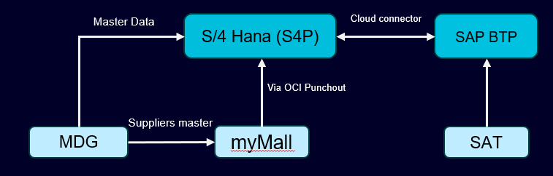
Direct X: Major Interfaces
SAP S/4HANA (S4P): Main SAP system in the SHERPA X landscape. In the Direct X Procurement process, the purchase requisition and the purchase order will be created and managed in S4P.
SAP Business Technology Platform (BTP): A comprehensive technology platform that integrates various services and tools to help businesses innovate and transform digitally, it is integrated with the SAP S/4HANA to manage the PR/PO forms & approval workflow.
SAT (Mendix): Signature Authorization Tool (SAT) is SHERPA X harmonized tool to manage the authorized approvers per each company code (ARE), cost center and profit center. The SAT will be used to determine the purchase order functional and commercial approvers.
SAP MDG (M4P): Controls the master data in SHERPA X, business partners including internal and external suppliers are centrally managed in MDG, creation and/or change of business partner data have to be executed in MDG first before such data is available in S4P system (e.g., supplier, material master).
myMall: Front end for all current OneSRM requesters to order products and services, in Direct X it is available via OCI punchout functionality only.

Slide 13
2. Purchase Requisition Process

Slide 14
Purchase Requisition Overview
Process description:
Requisitioner logs into SAP S/4HANA and creates purchase requisition.
The Requisitioner creates a purchase requisition (PR) with the Functional group (F01), adds mandatory information (account assignment without GR one) along with requisitioner, recipient details and saves it. After saving the PR, the system triggers the Release Strategy.
An email notification triggers to Requisitioner to verify the PR details.
The Requisitioner verifies the PR details and approves it in SAP BTP.
The Functional Buyer receives an email notification to review the PR and changes the purchase group from functional group (F01) to individual group (Ixx).
Purchaser, who is assigned to the (Ixx) purchasing group, receives an email notification to complete and confirm the PR.
Purchase requisition is released in S/4HANA system.
Requisitioner
Create/Save PR with Purchasing Group F01
PR Creator Receive a Notification Email and My Inbox
PR Creator Receive BTP Form to confirm PR
Buyer
Receive BTP Form to Assign Individual Purchasing Group (Ixx)
Buyer Receive a Notification Email and My Inbox
Purchaser
Receive a Notification Email and My Inbox
Purchaser Receive BTP Form to complete and confirm PR
PR Released
SAP BTP

Slide 15
3. PR - Assign Individual Purchaser Group - Buyer

Slide 16
PR - Assign Individual Purchaser Group - Buyer
Buyer Receive BTP Form to Assign an Individual Purchasing Group
Buyer will receive a form from BTP that will validate a few specific fields, and assign an Individual Purchasing Group:
Purchasing Organization
Purchasing Group
Account Assignment
Requisitioner GID
Recipient GID
Requisitioner
Create/Save PR with Purchasing Group F01
PR Creator Receive a Notification Email and My Inbox
PR Creator Receive BTP Form to confirm PR
Buyer
Receive BTP Form to Assign Individual Purchasing Group (Ixx)
Buyer Receive a Notification Email and My Inbox
Purchaser
Receive a Notification Email and My Inbox
Purchaser Receive BTP Form to complete and confirm PR
PR Released
SAP BTP

Slide 17
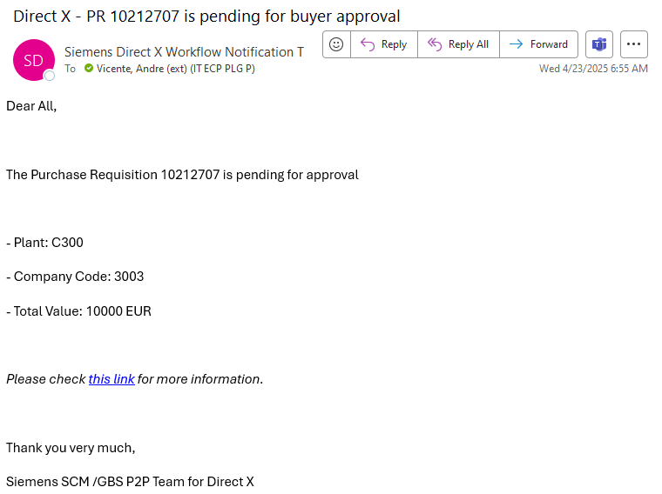
PR - Assign Individual Purchaser Group - Buyer
Email: Direct X - PR # is pending for buyer approval
Buyer will receive an email to validate the PR and Assign an Individual Purchasing Group.
The email body will include the PR Number and main Organization structure of this PR
Company Code: 3003
Purchasing Org: C300
Total value of the PR
Click on the Link to access the BTP My Inbox Form.

Slide 18
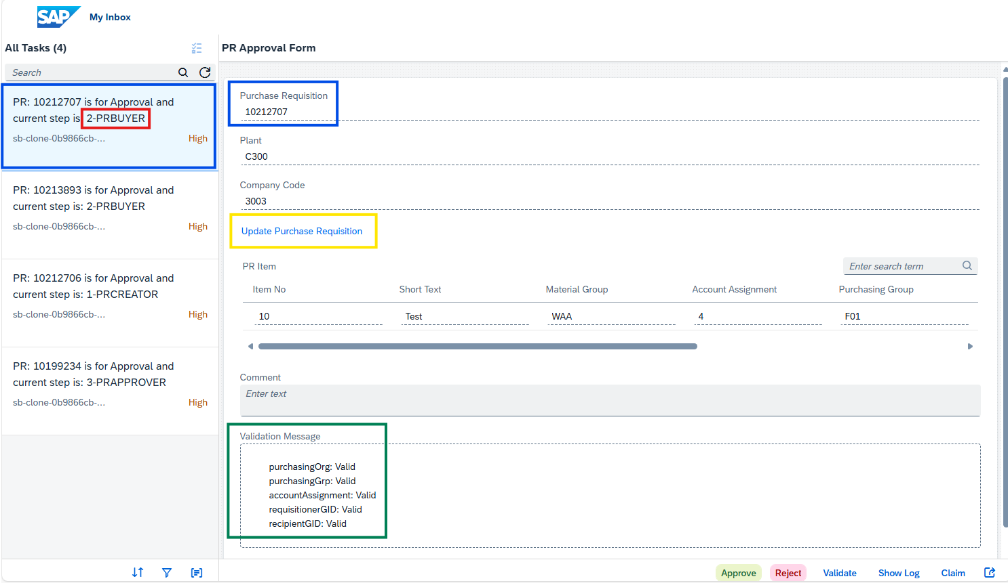
Confirm the Purchase Requisition
BTP – My Inbox – PR Approval Form
The second BTP Form is 2-PRBUYER
The buyer has to make sure that the correct PR number has been selected and appear in Form
Confirm the automatic validation will be performed in the PR line items for the fields:
Purchasing Organization
Purchasing Group
Account Assignment, has to be
4 – Cost center without GR
5 – Project without GR
A - Asset
Requisitioner, has to be a valid GID
Recipient
Item Category Standard → has to be valid GID
Item Category B-Limit → will be Empty
Click on “Update Purchase Requisition” to review the full PR data and assign an Individual Purchasing Group (IXX instead of F01)

Slide 19
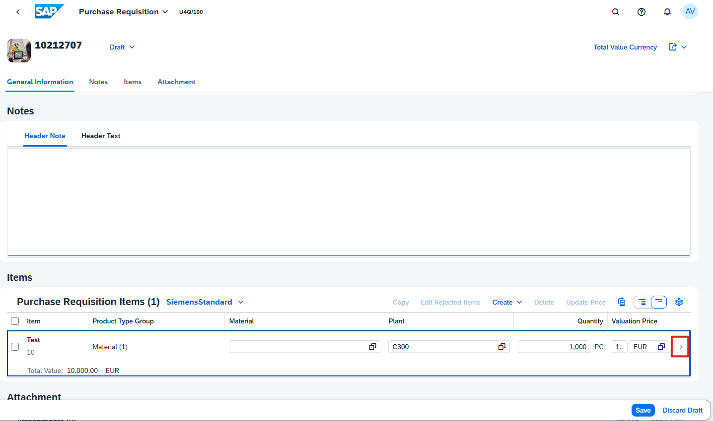
Confirm the Purchase Requisition
BTP – My Inbox – PR Approval Form
Click on the arrow on “Purchase Requisition Items” (Red highlight)

Slide 20
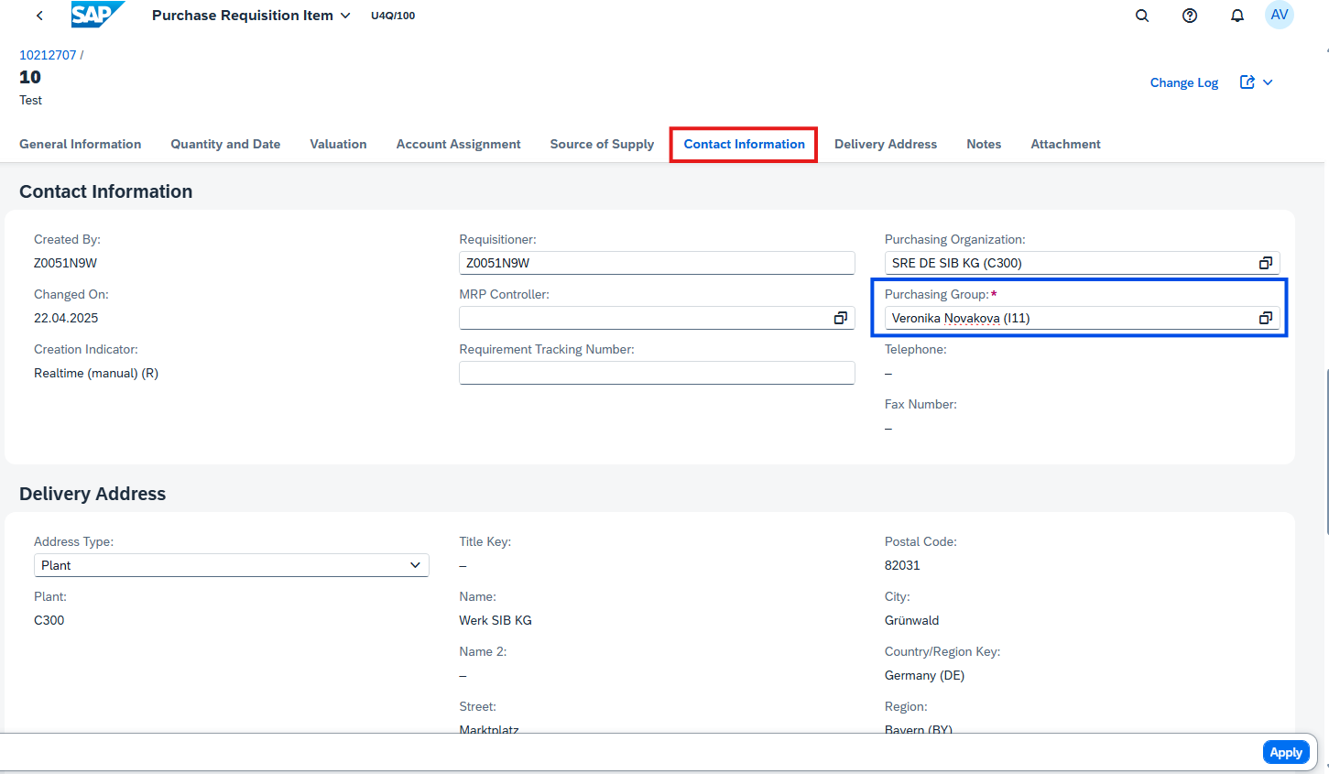
Confirm the Purchase Requisition
BTP – My Inbox – PR Approval Form
Select “Contact Information” tab
Change the F01 Purchasing Group, for an Individual Purchasing Group
Click on “APPLY”

Slide 21
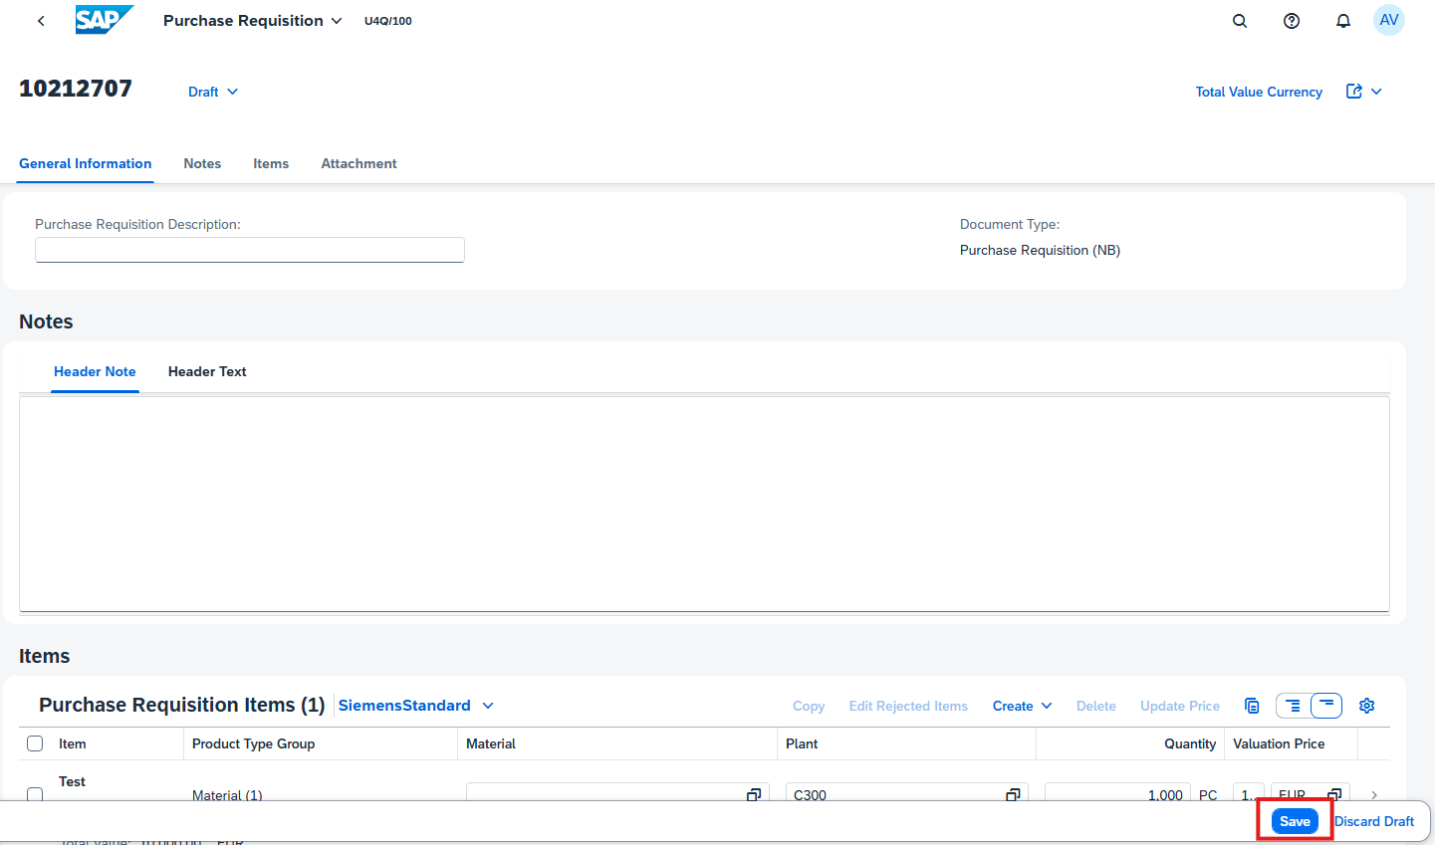
Confirm the Purchase Requisition
BTP – My Inbox – PR Approval Form
On the next screen, click on “SAVE”

Slide 22
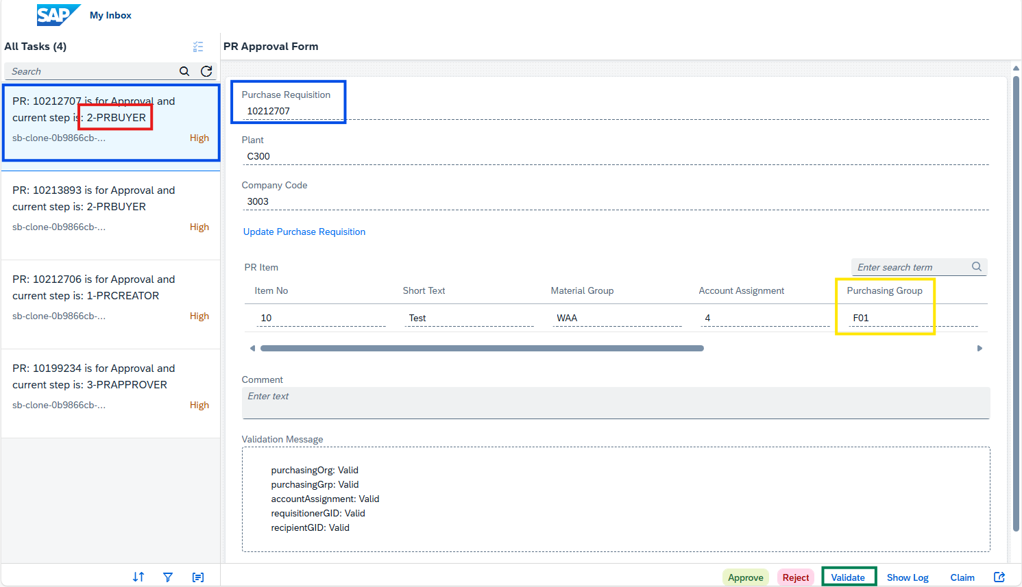
Confirm the Purchase Requisition
BTP – My Inbox – PR Approval Form
Return to BTP Inbox
Make sure, you are in the correct PR, which has to be validated and approved
Click on Validate, o have the information updated on the BTP form.
In this example, the Purchasing Group will be changed from F01 to I11
Refresh the BTP Inbox page

Slide 23
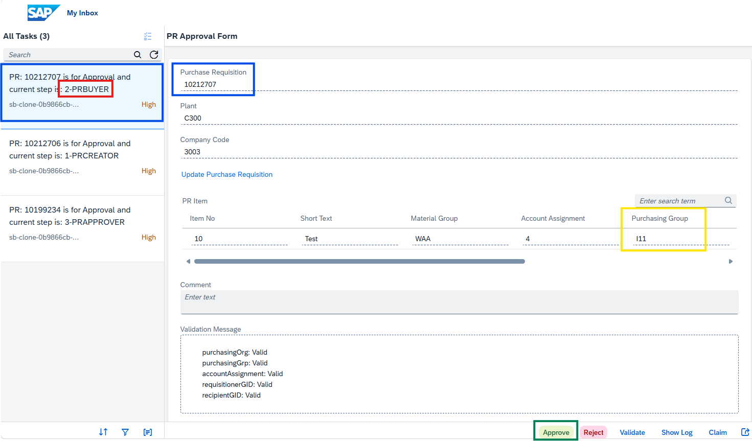
Confirm the Purchase Requisition
BTP – My Inbox – PR Approval Form
After VALIDATE and REFRESH the page
Check, if in the Validation Message are all data still Valid
In this example: the Purchasing group was changed from F01 to I11 – is to Check, if change is visible
Click on Approve to send this PR to the individual Purchaser acc. The Purchasing group

Slide 24
4. PR - Purchaser Confirmation - Purchaser

Slide 25
4.1 PR - Purchaser Confirmation - Purchaser
Purchaser Receive BTP Form to Individual Approval
Purchaser will receive a form from BTP with a validation of a few specific fields.:
Purchasing Organization
Purchasing Group
Account Assignment
Requisitioner GID
Recipient GID
Requisitioner
Create/Save PR with Purchasing Group F01
PR Creator Receive a Notification Email and My Inbox
PR Creator Receive BTP Form to confirm PR
Buyer
Receive BTP Form to Assign Individual Purchasing Group (Ixx)
Buyer Receive a Notification Email and My Inbox
Purchaser
Receive a Notification Email and My Inbox
Purchaser Receive BTP Form to complete and confirm PR
PR Released
SAP BTP

Slide 26
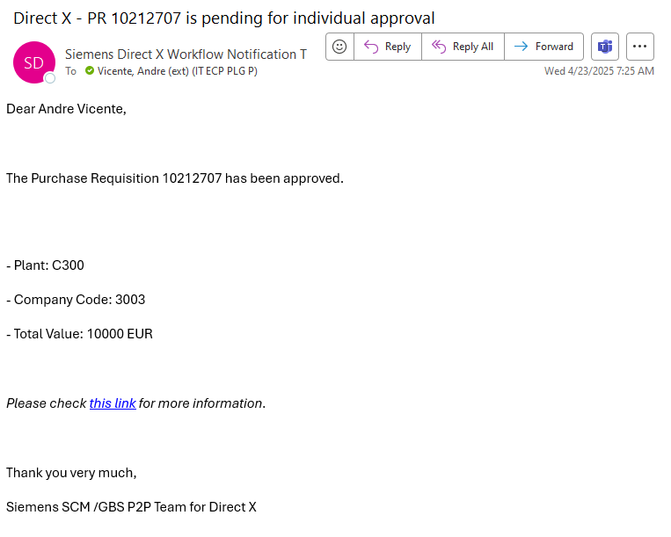
4.1 PR - Purchaser Confirmation - Purchaser
Email: Direct X - PR # is pending for individual approval
Purchaser will receive an email to validate the PR data
The email body will include the PR Number and main Organization structure of this PR
Company Code: 3003
Purchasing Org: C300
Total value of the PR
Click on the Link to access the BTP My Inbox Form.

Slide 27
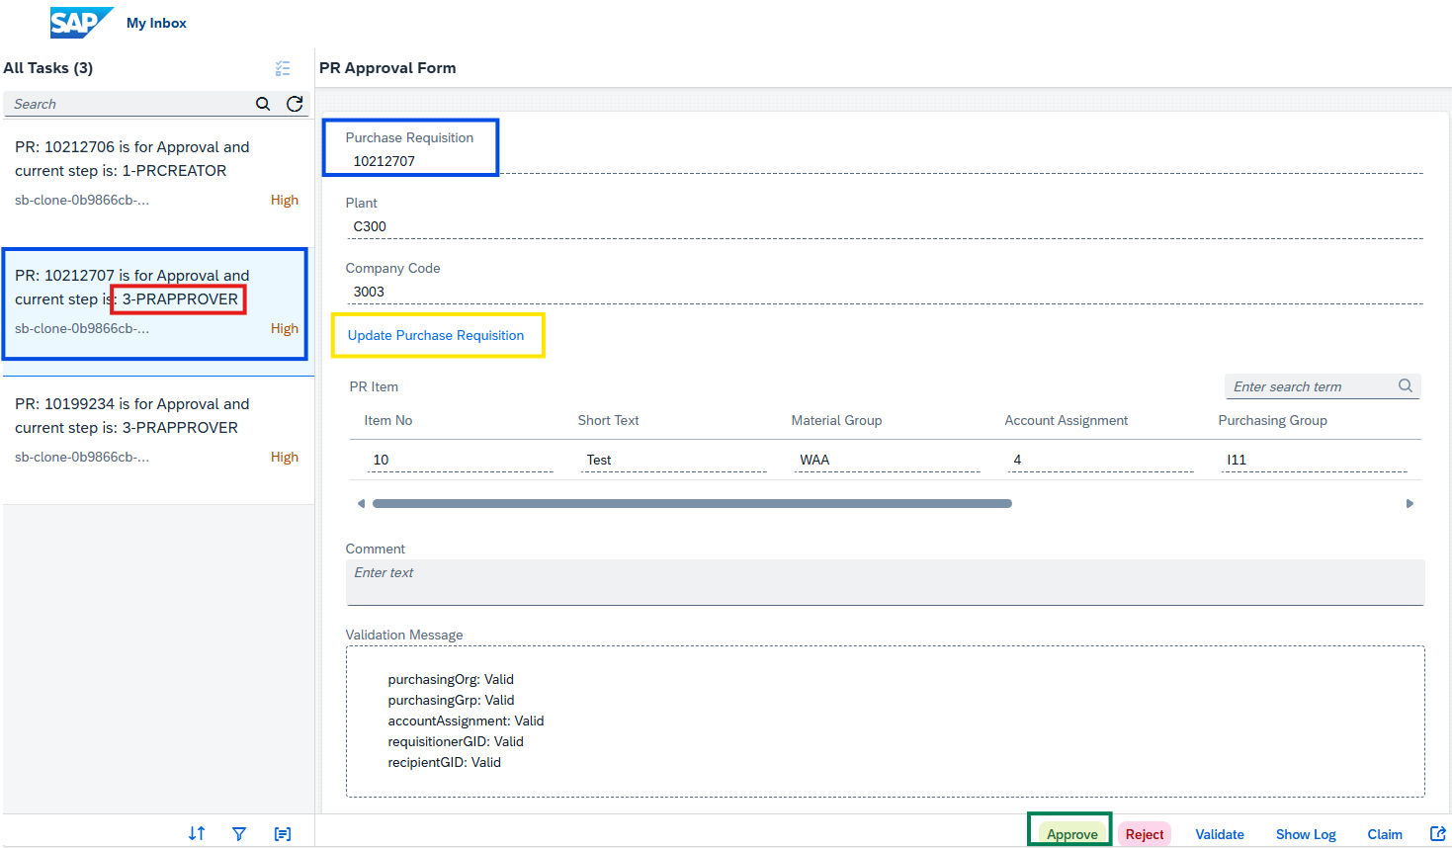
4.2 Confirm the Purchase Requisition
BTP – My Inbox – PR Approval Form
The third BTP Form is 3-PRAPPROVER
The Purchaser has to make sure that the correct PR number has been selected and appear in Form.
Click on “Update Purchase Requisition” to review the full PR data
After PR data validation, click on “APPROVE” to finish the Purchase Requisition steps and fully approve it, to be used on Purchase Order creation steps.

Slide 28
4.3 PR - Release Statuses
After the final Purchaser step, the status of the PR will be converted from “In Release” to “Release Complete”
Requisitioner
Create/Save PR with Purchasing Group F01
PR Creator Receive a Notification Email and My Inbox
PR Creator Receive BTP Form to confirm PR
Buyer
Receive BTP Form to Assign Individual Purchasing Group (Ixx)
Buyer Receive a Notification Email and My Inbox
Purchaser
Receive a Notification Email and My Inbox
Purchaser Receive BTP Form to complete and confirm PR
PR Released
SAP BTP

Slide 29
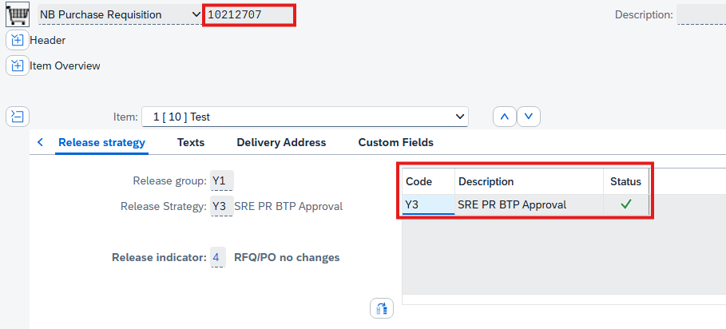
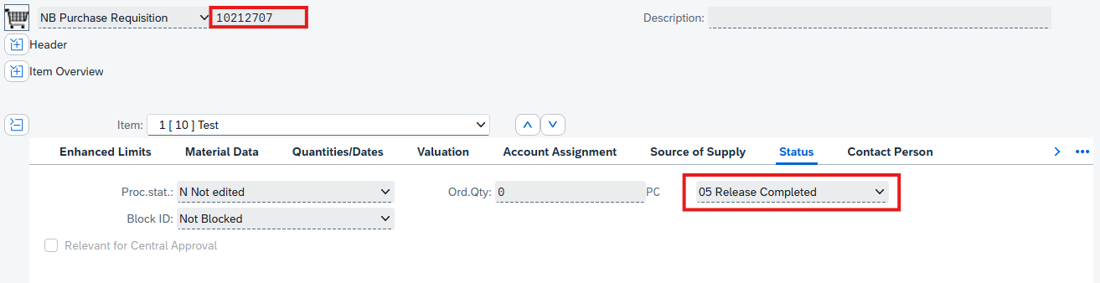
4.3 PR - Release Statuses
ME33N – Display and Maintain Purchase Requisition - Advanced
Release Status: “Release Completed”
Further Activities could be performed in this PR:
PO can be created

Slide 30
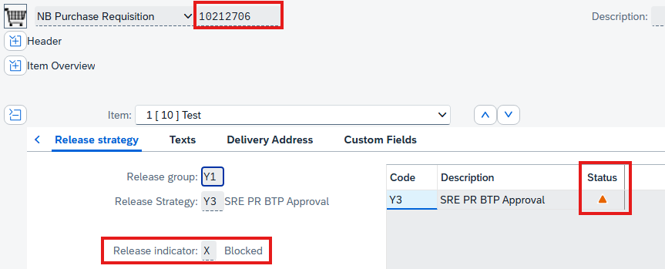
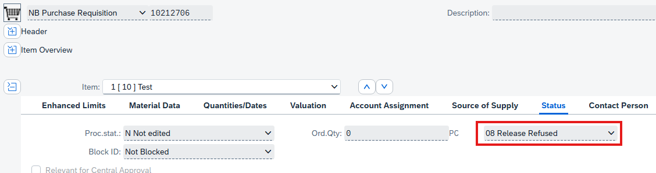
4.3 PR - Release Statuses
ME33N – Display and Maintain Purchase Requisition - Advanced
Release Status: “Release Refused”
No further Activities could be performed in this PR
PO cannot be created
This status will be reached, if the PR has been rejected at any of the workflow steps
Requisitioner
Buyer
Purchaser

Slide 31
5. Purchase Order Process

Slide 32
Purchase Order Overview
Process description:
The Purchaser creates the PO with reference to the released PR from Fiori app. After creating the PO, the system triggers the Release Strategy
An automatic check on PO will be executed to determine if a Procurement Expert approval is required or not.
Procurement Expert is required, if the assigned individual Purchasing Group (IXX) is not a Procurement Expert and the PO total value is higher than 50.000 EUR.
The Purchaser will receive an SAP BTP notification to select the Procurement Expert (if required).
SAP BTP will send an acknowledgement notification to the Purchaser to check and confirm the PO data.
The Procurement Expert will do a quality check of the PO in S4P and acknowledges it via SAP BTP email notification (if required).
Afterwards the SAT approval is started for POs above 1.000 EUR for maximum 2 approval levels (Functional and Commercial).
Procurement Expert
Expert Approval
Create/Save PO with reference to the PR
Yes
Expert
Purchaser
Select the Expert (if Required)
Receive BTP Form to Confirm the PO
No
SAT
No
PO Released
Approver
Yes
Functional Approval
Commercial Approval
SAP BTP

Slide 33
Purchase Order Document types
Relevant PO types in Direct X:
YDNB – Direct purchase order
YDFO – Framework purchase order
 | YDNB – Direct PO | YDFO – Framework PO
Usage | Used for the normal service which could be ordered by a certain quantity and a price per each UOM in a certain delivery date. | Used for a long delivery period and the Start and End dates have to be inserted
Item Category | Standard | Standard (one invoice is awaited) B – Limit (more invoices are awaited)

Slide 34
Purchase Order Item Category
 | Standard (FO / NB PR Type) | B – Limit (FO Type)
Account Assignment | 4 – Cost center without GR 5 – Project without GR A – Asset | 4 – Cost center without GR 5 – Project without GR
Account Assignment tab | The fields in the tab will be editable Recipient GID is required | Will be inserted in the Limits tab Recipient GID is not required
Item Price | Inserted in the Net Price field per price unit | Expected value and Overall limit will be inserted in the Limits tab
Invoice Receipt | Standard item category invoicing is based on Quantity | Limit item category invoicing is based on Value

Slide 35
Converting Purchase Requisition to Purchase Order
NB – Purchase Requisition
- Standard Item Category
Convert to
YDNB – Direct PO
- Standard Item Category
Converting purchase requisition to purchase order is depending on a configured link between document types and item category.
For Direct X procurement, there are 3 possible combinations.
You have to select the correct document type at the PO creation step.
The system will give an error if you try to convert a NB purchase requisition to YDFO purchase order.
FO – Framework Requisition
- Standard Item Category
Convert to
YDFO – Framework PO
- Standard Item Category
FO – Framework Requisition
B - Limit Item Category
Convert to
YDFO – Framework PO
B - Limit Item Category

Slide 36
Related Purchaser Fiori Apps
System | Fiori App ID | Title | Remarks
S4P | F0842A | Manage Purchase Orders | Used for create PO with document type “NB” and item category standard to PO This application will be the default app in the PO related BTP Forms
S4P | ME21N | Create Purchase Order | Used for creating new PO with reference to PR line items
S4P | ME22N | Change Purchase Order | Used for changing the PO
S4P | ME23N | Display Purchase Order | Used for displaying the PO
S4P | CV01N | Create Document | Used to upload document into the SAP Archive
S4P | Obligo | Obligo | Report with a list of Positions with the related invoiced values
S4P | Purchasing Activity | Purchasing Activity | Report with a list of Positions with ordered value and quantity
BTP | My Inbox | My Inbox | Used for PR and PO workflow confirmations and approvals This application will be the default app in the PR/PO related BTP emails

Slide 37
6. Purchase Order Creation

Slide 38
6.1 Create Purchase Order – Process Overview
Procurement Expert
Expert Approval
After the purchase requisition is released you, as the purchaser, can create the purchase order. The creation and the release of the PO will be controlled by a workflow on SAP BTP.
The main steps to create the PO are
Search for the PR
Convert PR to PO
Complete the PO data and save it
Create/Save PO with reference to the PR
Yes
Expert
Purchaser
Select the Expert (if Required)
Receive BTP Form to Confirm the PO
No
SAT
No
PO Released
Approver
Yes
Functional Approval
Commercial Approval
SAP BTP

Slide 39
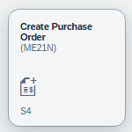
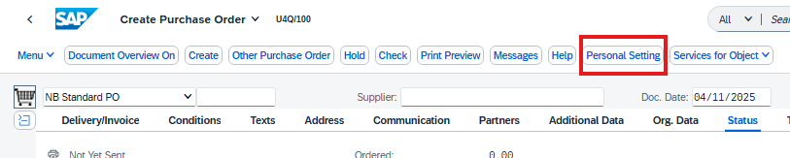
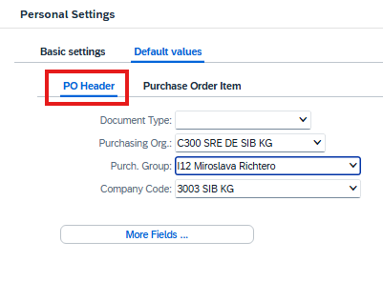
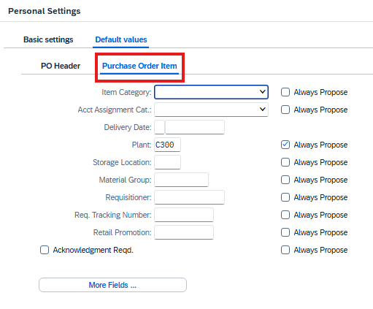

6.2 Purchase Order Personal Settings
ME21N - Create Purchase Order
Personal Settings
General settings to support the user for an easy navigation in the Purchaser Order screen.
Click on “Personal Settings”
Select the “Default values” tab to set the default values at Header and Item
Header
Document type: (recommended) don’t select a “Document type” to be able to select the correct type and don’t depend on the default values while converting the PR to PO
Purchasing Org: C300 SRE DE SIB KG
Purchasing Group: Select the Individual Purchasing Group
Company code: 3003 SIB KG
Item
Plant: C300
Click “Save” on the screen bottom to save the settings.

Slide 40
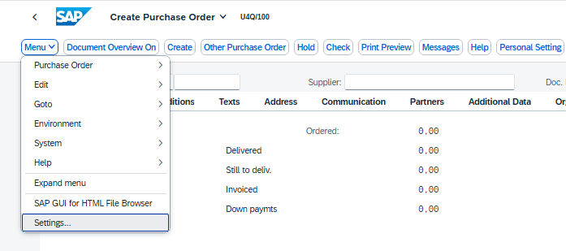
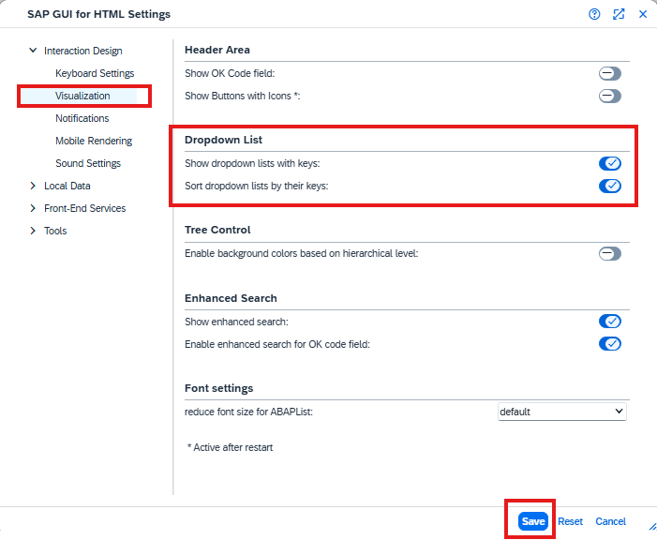
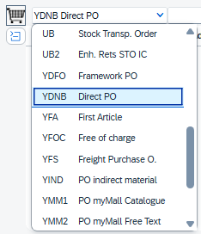
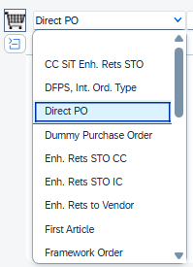
6.2 Purchase Order Personal Settings
ME21N - Create Purchase Order
Visualization Settings
Click on the “Menu” button (in other visualization Button)
Select “Settings”
Then “Visualization”
Select “Show dropdown lists with keys” and “Sort dropdown lists by their keys”
Then “Save”
With this setting the user will be able to see the Key codes beside the description.
For Example:
PO doc type will be “YDNB Direct PO” not only “Direct PO”

Slide 41
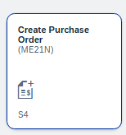
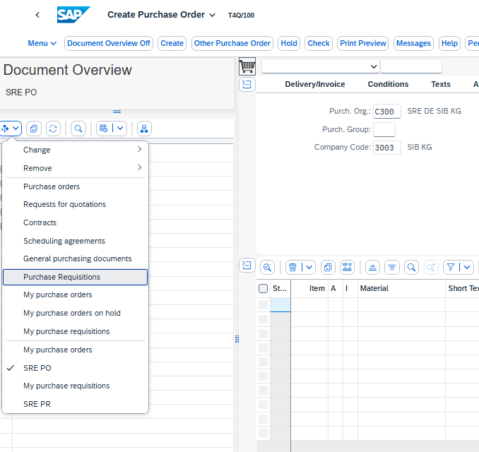
6.3 Search for the PR – ME21N – Document Overview
ME21N – Create Purchase Order
Recommended way to directly search and convert the PRs to PO (The same could be performed in ME2xN and ME5xN Fiori apps)
Click on “Document Overview” button
A “Document Overview” section will appear on the left to the PO creation screen
Click on the “Select Variant” and select “Purchase Requisitions”

Slide 42
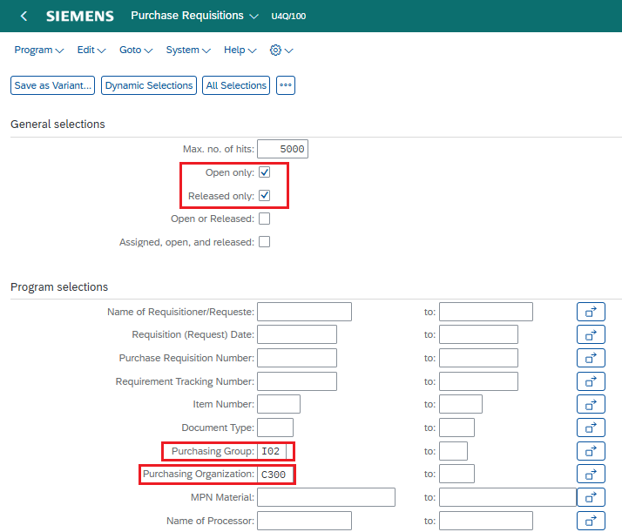
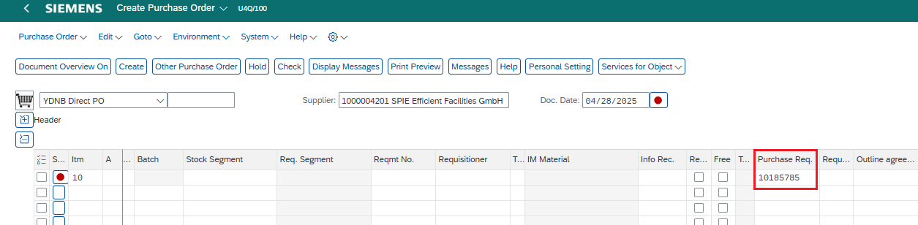
6.3 Search for the PR – ME21N – Document Overview
ME21N – Create Purchase Order
Insert the searching values
General selections section
Select the “Released only” and „Open only“ PRs
Program selections
Purchasing Group: IXX
Purchasing organization: C300
If the PR number is known, then directly insert it in the “Purchase Requisition number” field

Slide 43
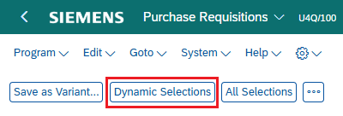
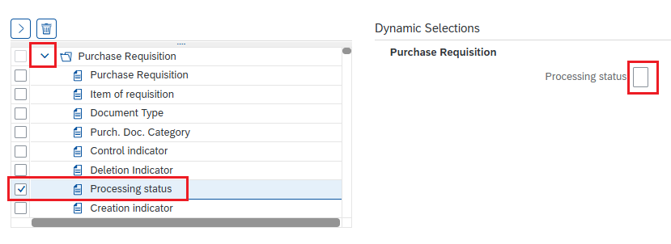
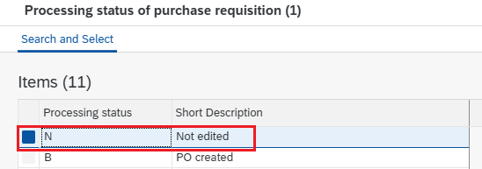

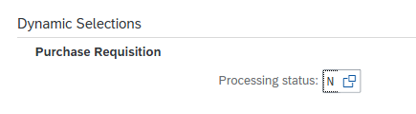

6.3 Search for the PR – ME21N – Document Overview
ME21N – Create Purchase Order
Dynamic selection is available in this report to include the additional PR fields to the searching criteria
Click on the “Dynamic Selections” button
Open the “Purchase Requisition” folder icon
Double click on the needed category to include it in the “Dynamic Selections” section
Choose the option or fill the value
Confirm with OK
Value appears in the „Dynamic Selection“
Execute, to see only PRs, with filtered values

Slide 44
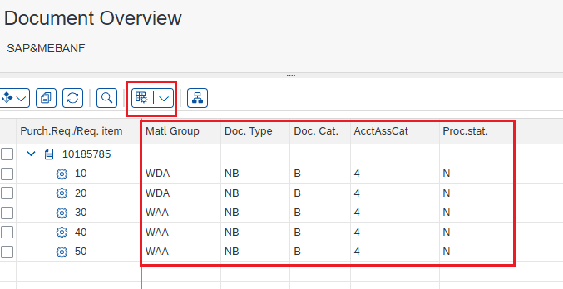
6.3 Search for the PR – ME21N – Document Overview
ME21N – Create Purchase Order
Result
The selected PRs will be displayed in the “Document Overview” section
Selected PRs are Released (Release: 4-RFQ/PO no changes) and No PO has been created for any of them (Proc. Stat.: N-Not Edited)
1st with Document type “FO” and item category limit
2nd with Document type “NB” and item category standard
The Document overview layout can be changed
Click on “Select layout” to add required fields to the PR

Slide 45
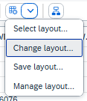
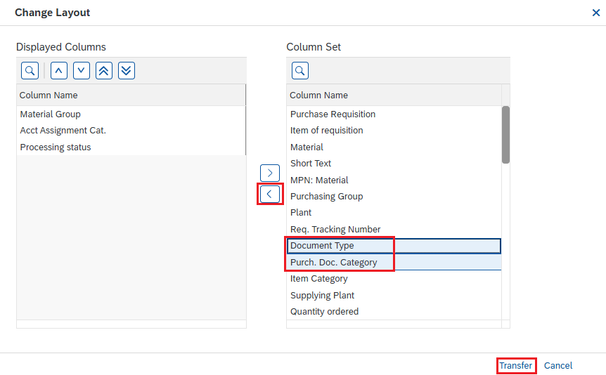
2. Search for the PR – ME21N – Document Overview (6/6)
ME21N – Create Purchase Order
Select layout
After clicking on the “Select layout” icon a change layout screen will appear to selected required PR fields to be displayed in the “Document overview area”
Select needed columns on the right side and mark them
Click on the button to move the columns to the left side
Click “Transfer” to show the selected fields
If the layout has to be saved, click “Select layout” icon and click on “Save layout”. Then next time, user has to click directly on “Select layout” icon to select the saved one.

Slide 46
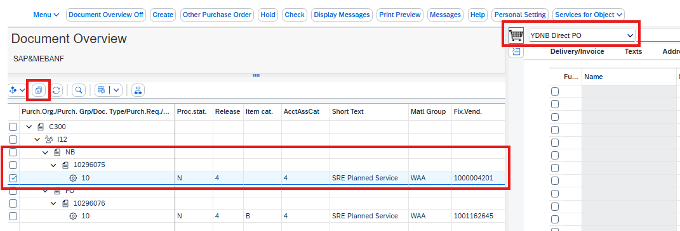
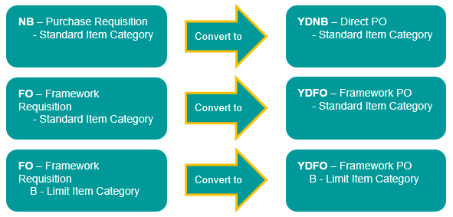
6.4 Convert Purchase requisition to Purchase order
ME21N – Create Purchase Order
In this step you as the purchaser have to copy the PR line item values to the purchase order screen.
1. Open the “Document Overview” section and click on the “Selection Variant” then select the “Purchase Requisitions” to search for the required PRs
2. Click on the checkbox icon for the related PR line item, which line-item be converted to PO (or on checkbox by the PR number – the whole PR will be transfered into the PO)
3. Select the PO Document Type: YDNB – Direct PO or YDFO – Framework order
4. Click on ( ) “Adopt” icon to copy the PR line-item values to the PO

Slide 47
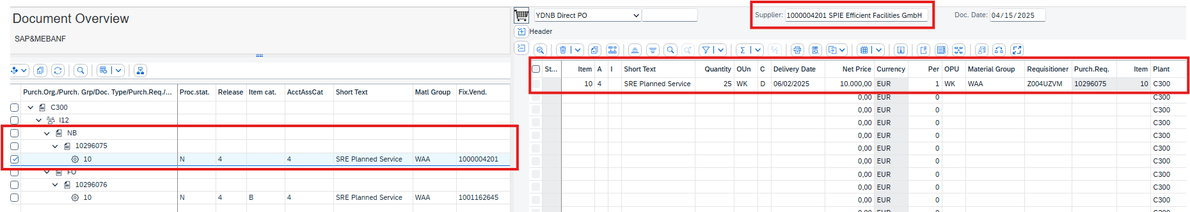
6.4 Convert Purchase requisition to Purchase order
ME21N – Create Purchase Order
All the inserted data on the PR line item are automatically copied to the PO creation screen.

Slide 48
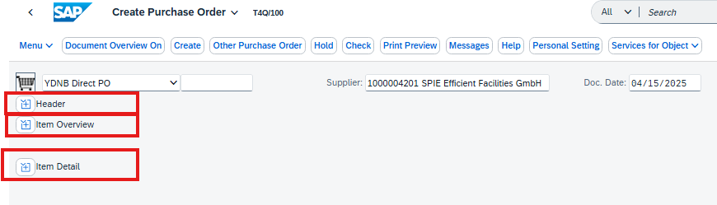
6.5 Complete the PO data and Save it
ME21N – Create Purchase Order
In this step you as the purchaser has to review all the copied data in the PO before click on “Save”
The Purchase Order values are distributed among three sections
1. Header includes data, where are related to all the PO line items
2. Item Overview includes the main data for the line item
3. Item Detail includes detail data per each line item

Slide 49
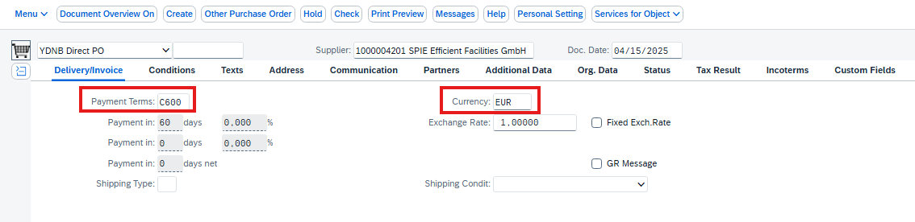
6.5 Complete the PO data and Save it
ME21N – Create Purchase Order
Header – Delivery/Invoice
1. Payment Terms: are determined by the supplier master data (can be changed, if required)
2. Currency: is determined by the supplier master data

Slide 50
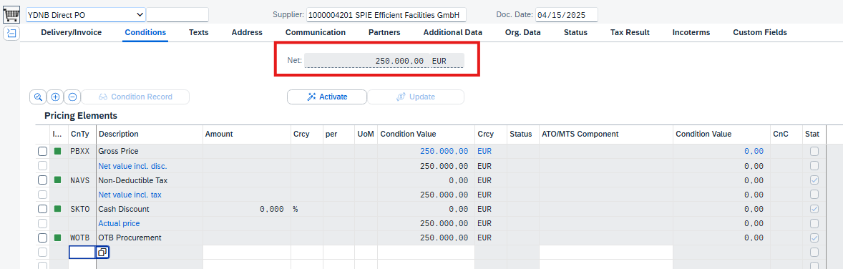
6.5 Complete the PO data and Save it
ME21N – Create Purchase Order
Header – Conditions
Net Price: A display only field to show the total amount of the PO
The release strategy and approval process are depending on this value to determine the release strategy and the selection of the approvers

Slide 51
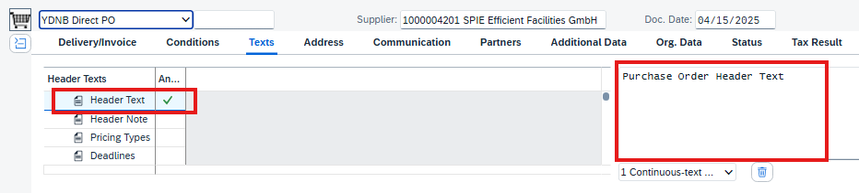
6.5 Complete the PO data and Save it
ME21N – Create Purchase Order
Header – Texts
Header Text - The Purchaser could add additional texts to the PO, and they will be printed in the PO printout.
Header Note – is applicable for internal notes and will be not printed on the PO

Slide 52
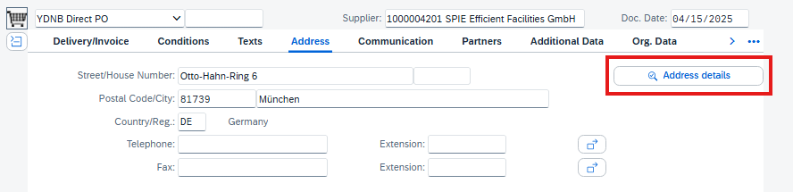
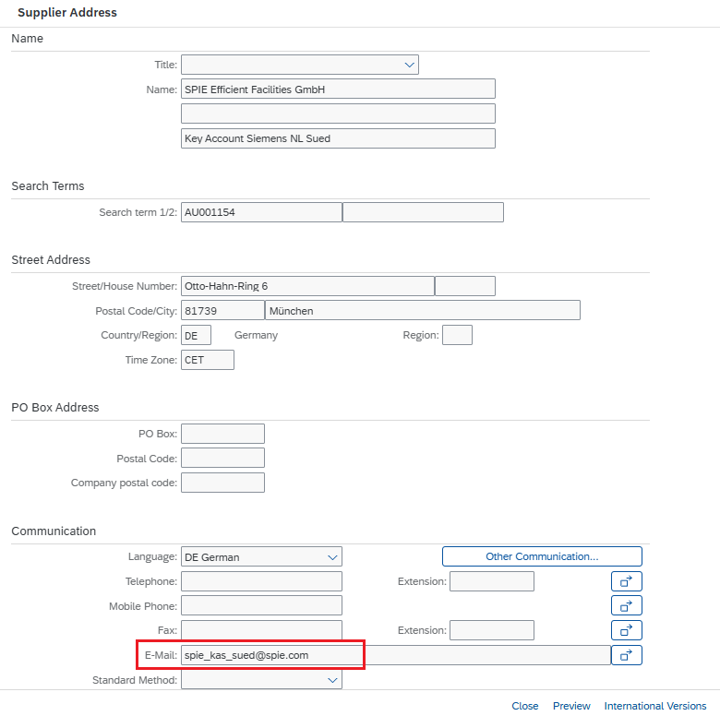
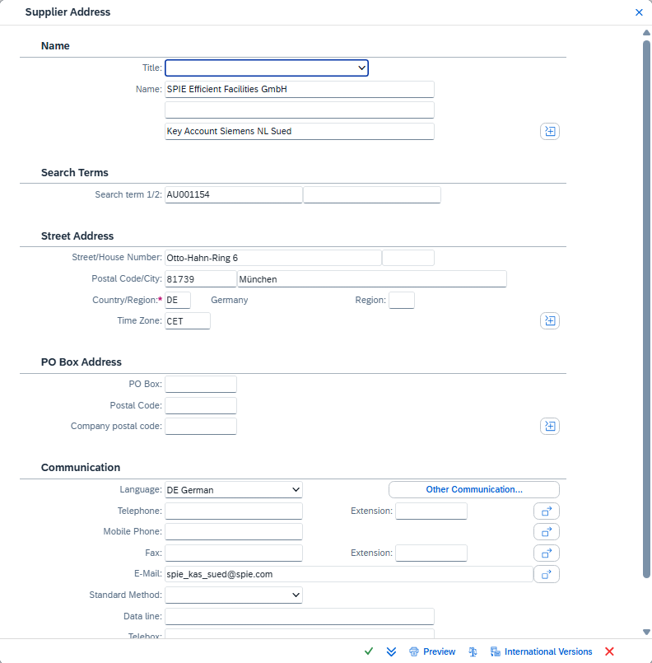
6.5 Complete the PO data and Save it
ME21N – Create Purchase Order
Header – Address
The address will be by default copied from the supplier master data.
Click on “Address details” for more information on the supplier address. Check, if the email address exists in the supplier master data.

Slide 53
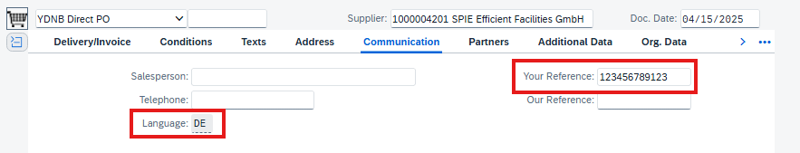
6.5 Complete the PO data and Save it
ME21N – Create Purchase Order
Header – Communication
Your Reference: insert the Supplier Contract (if required). This field will be printed
Language: Supplier default language determined from the Supplier master data and will be used for Supplier communication (ex. Printout)

Slide 54
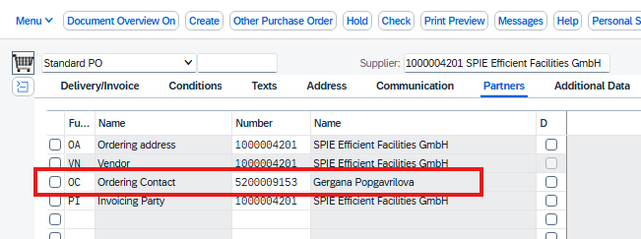
6.5 Complete the PO data and Save it
ME21N – Create Purchase Order
Header – Partner Function
In this tab all the required partners for this purchase order will be included, for example the ordering address and the invoicing party of the supplier. In most of the cases, all partners will be assigned to the same supplier number.
The partner function “OC – Ordering Contact” has to be included in the purchase order to be able to send the PO to the supplier by Email. The partner role “OC – Ordering Contact” is a part of the supplier master data If “OC – Ordering Contact“ role is missing,” the PO will not be sent to the supplier by email. – More information you can find in the chapter 13. Purchase Order Output.
Header – Messages
Output condition Medium for Direct X Procurement
EDI → “6 - EDI”
Email → “5 – External Send”
Printout Form → “1 – Print output”

Slide 55
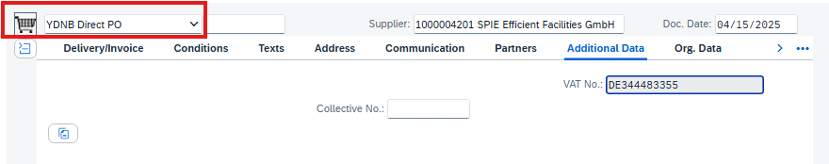
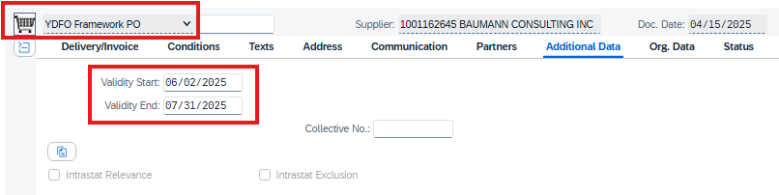
6.5 Complete the PO data and Save it
ME21N – Create Purchase Order
Header – Additional Data
For the PO Type “YDFO – Framework PO” is necessary to enter the Validity Start and Validity End date. This information appears on the PO Print out.
No action required for the PO type „YDNB – Direct Order“

Slide 56
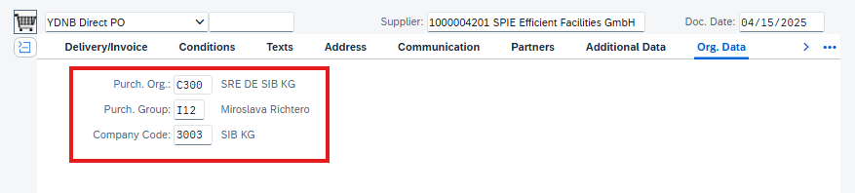
6.5 Complete the PO data and Save it
ME21N – Create Purchase Order
Header – Org. Data
Purch. Org: C300 – SRE DE SIB KG
Purch. Group: insert the Purchasing Group, which represents the individual Purchaser (I01 → I12)
Company Code: 3003 – SIB KG

Slide 57
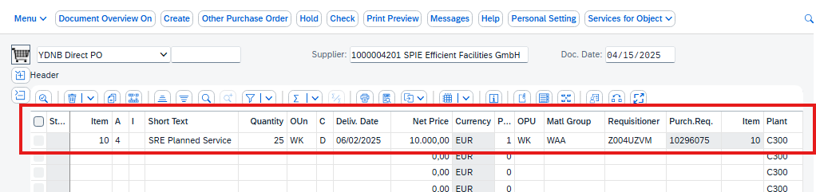
6.5 Complete the PO data and Save it
ME21N – Create Purchase Order
Item – Overview
Includes the main item data
Account Assignment: allowed values for Direct X procurement
4 – Center without GR
5 – Project without GR
A - Asset
Item Category: depending on the document type
YDNB – Direct PO
Standard (no special sign, field is blank)
YDFO – Framework PO
Standard (no special sign, field is blank)
B - limit

Slide 58


6.5 Complete the PO data and Save it
ME21N – Create Purchase Order
Item Detail – Limits (only available for YDFO purchase orders)
The Limit tab will appear only for item category “B - Limit” in the “YDFO – Framework Order” type.
This tab includes the
Overall Limit: this will be the max amount for invoicing
Expected value: which is the main value for the PO line item

Slide 59

6.5 Complete the PO data and Save it
ME21N – Create Purchase Order
Item Detail - Delivery
By default, the “Goods Receipt” and “GR Non-Valuated” fields will be not selected based on the correct Account Assignment selection.
Make sure that they are not checked.

Slide 60

6.5 Complete the PO data and Save it
ME21N – Create Purchase Order
Item Detail – Account Assignment
Account Assignment tab will behave differently based on the item category.
Standard item category
Insert the account values (cost center, WBS element or Asset), based on the selected account assignment.
The recipient will be copied from the PR and a valid user GID has to be inserted based on the following:
The Recipient will receive the Service Confirmation workflow from VIM (Vendor Invoice Management)
The Recipient contact data will be printed in the commercial contact section in the PO printout

Slide 61



6.5 Complete the PO data and Save it
ME21N – Create Purchase Order
Item Detail – Account Assignment
Account Assignment tab will behave differently based on the item category.
B - Limit item category
Account Assignment tab will be display only and the account values will be inserted in the “Limit” tab.
Click on ( ) account assignment icon
Insert the account assignment category
In this case the only the Recipient field could be empty and based on that
The Service Confirmation workflow from VIM (Vendor Invoice Management) will be sent to the user GID maintained in the Requisitioner field
The Purchasing Group contact data will be printed in the commercial contact section in the PO printout

Slide 62


6.5 Complete the PO data and Save it
ME21N – Create Purchase Order
Item Detail – Account Assignment
Multiple Account Assignment required => click on the button
Field „Distribution“ wil be activated

Slide 63

6.5 Complete the PO data and Save it
ME21N – Create Purchase Order
Item Detail – Confirmations
Insert the Confirmation Control Key “Y004 – Direct Conf.”, if a vendor response is required
Only Order Acknowledgement is expected from the supplier without goods receipt.

Slide 64


6.5 Complete the PO data and Save it
ME21N – Create Purchase Order
After completing and reviewing the PO data, the final steps is required
Click on “Check” button to make sure that there is no missed/wrong data
In Header section, check the “Release Strategy” tab, the “SRE PO BTP Approval” will be automatically selected to start the PO workflow on BTP, without it the process will not work
Release Strategy required the following data
PO document type: “YDNB” or “YDFO”
Company Code: “3003”
Purchasing Organization: “C300”
Purchasing Group: Individual Purchasing Group (I01 → I14)
Click on “Save” to save the PO and a success message will appear with the created PO number.

Slide 65
7. Adding Attachment to Purchase Order

Slide 66



7.1 Adding Attachment to Archive
CV01N - Create Document
The “Create Document: Initial Screen” screen will open.
Select the Document Type as “DRW” and click on enter.
A Primary/Initial status tab will open
Select RE – Released and click on OK.

Slide 67



7.1 Adding Attachment to Archive
CV01N - Create Document
A new tab: Create Document : Basic Data Drawing will be opened
Add the description in the Document data tab.
Click on create original
A new box: Create Document : Basic Data Drawing (DRW) will be opened
Select the Application type – PDF
Add the Description
Click on Original
Below box will be opened, click on OK

Slide 68



7.1 Adding Attachment to Archive
CV01N - Create Document
A new tab will be opened, select the required document that you want to upload and click on Open
In Create Document: Basic Data Drawing (DRW) click on Tick,
The added document will be Shown in the Originals Section, we can double click on the document to view the document..

Slide 69



7.1 Adding Attachment to Archive
CV01N - Create Document
To Archive the document, select the document and click on „Check in Orig“.
A Box Check in Document: Kpro will be opened
Select Z_DMS_11 – DMS Archiving with 10 Year Retention period and click on tick mark to add the document into Archiving.Storage category.

Slide 70


7.1 Adding Attachment to Archive
CV01N - Create Document
Click on „Save“ and the document number will be created.
Copy it

Slide 71

7.2 Adding Attachment to Purchase Order
ME21N - Create Purchase Order
Select the line item
Click on documents to upload the needed attachments

Slide 72


7.2 Adding Attachment to Purchase Order
ME21N - Create Purchase Order
A new Tab will be opened Purchase Order Item – Link to Document
Click on the document search
A new tab Restrict Value Range (1) will be opened
Provide the Document Type and Document number (Which was created earlier)
Click on Go and the Item will be appeared in Items section
Click on OK to add the document into the PR line item.

Slide 73
8. Procurement Expert Selection

Slide 74
Procurement Expert Selection
The Purchaser will receive an email directly after creating the PO (with the release strategy).
The Purchaser has to perform 2 activities in 2 separate steps:
Select Expert (if required)
Form Name: PO Update Expert Form
Confirm the PO
Form Name: POValidationForm
In this chapter, 1st step will be explained.
Procurement Expert
Expert Approval
Create/Save PO with reference to the PR
Yes
Expert
Purchaser
Select the Expert (if Required)
Receive BTP Form to Confirm the PO
No
SAT
No
PO Released
Approver
Yes
Functional Approval
Commercial Approval
SAP BTP

Slide 75

Procurement Expert Selection
The selection of a procurement expert based on the total amount of the PO.
PO < 50.000 EUR – no expert needed, PO approved with one purchaser step
PO > 50.000 EUR – expert needed, the additional expert workflow is triggered – only in case, that the PO Creator (purchaser) is without expert role
The Procurement Expert in the Direct X Procurement process is one of the Purchasers with expert role and his approval serves as a quality gate to review the PO data and ensure that the PO is ready to be sent to the supplier.
The Procurement Expert will have a normal Purchaser role on S4P system but will be determined in the PO workflow based on a condition table in SAP BTP.

Slide 76

Procurement Expert Selection
Email: Direct X – PO # has been sent for validation
PO Creator/Purchaser will receive an email to validate the PO.
The email will include the PO number and main organization structure of the PO:
Company Code: 3003
Purchasing Org: C300
Purchasing Group: The individual Purchasing Group
Total value of the PO
Click on the Link to access the BTP My Inbox Form.

Slide 77



Procurement Expert Selection
S4P → ME23N – Display Purchase Order
BTP → My Inbox – PO Update Expert Form
In the Example: (PO: 4500105932)
The Expert will be selected in the BTP notification Form
A list of all the Experts in the BTP condition table will appear to select from
BTP

Slide 78

Procurement Expert Selection
S4P → ME23N – Display Purchase Order
BTP → My Inbox – PO Update Expert Form
In the Example: (PO: 4500105932)
Select the Expert (Purchasing Group - GID)
Click “Submit”
An email and BTP notification will be sent to the selected Expert to review and Approve/Reject the PO after confirming the PO line-item data by the Purchaser.
BTP

Slide 79
9. Confirm the Purchase Order

Slide 80
Confirm the Purchase Order
Procurement Expert
Expert Approval
The Purchaser will receive an email directly after creating the PO (with the release strategy).
The Purchaser has to perform 2 activities in 2 separate steps:
Select Expert (if required)
Form Name: PO Update Expert Form
Confirm the PO
Form Name: POValidationForm
In this chapter, 2nd step will be performed.
Create/Save PO with reference to the PR
Yes
Expert
Purchaser
Select the Expert (if Required)
Receive BTP Form to Confirm the PO
No
SAT
No
PO Released
Approver
Yes
Functional Approval
Commercial Approval
SAP BTP

Slide 81


Confirm the Purchase Order
BTP – My Inbox – POValidationForm
In case if the PO requires a Procurement Expert approval, then Purchaser has to do refresh ( ) the “All Tasks” list to show the “POValidationForm”.
The Purchaser has to make sure that the correct PO number has been selected and appear in Form (Blue highlight).
An automatic Validation will be performed in the PO line items for the fields:
Purchasing Organization
Purchasing Group
Account Assignment, has to be
4 – Center without GR
5 – Project without GR
A - Asset
Requisitioner, has to be a valid GID
Recipient
Item Category Standard → has to be valid GID
Item Category B-Limit → will be Empty
Results of the validation:
All data are “Valid (1)” => PO can be directly approved
Something is “Not Valid (2)” (here “RecipientGID”) => data are to review
=> Click on “Manage Purchase Order” to review the full PO data
Case 1 – For “YDFO” PO with Item Category B-Limit – Display Purchase Order Advanced app will open
Case 2 – For “YDNB” PO – Manage Purchaser Order Fiori app will open
2.
1.

Slide 82

Confirm the Purchase Order
Case 1 – YDFO – Framework Order
ME23N – Display Purchase Order Advanced
Case 1 – For “YDFO” PO (1/1)
The purchase order will be in a display mode and to switch to the change mode, click on “Display/Change” button
If Check/changes done, click od Save

Slide 83

Confirm the Purchase Order
Case 2 – YDNB – Direct Order
F0842A – Manage Purchase Orders
Case 2 – For “YDNB” PO (1/5)
“Manage Purchase Order” Fiori app will open
In the Next steps, the Recipient and Material Group will be changed
1. After clicking on “Edit”, the PO fields will be editable
2. Click on the small arrow ( ) in the “Purchase Order Items (1)” section to open the PO item details
The purchase order will be in a display mode and to switch to the change mode, click on “Edit” button

Slide 84
Confirm the Purchase Order
Case 2 – YDNB – Direct Order
App ID – F0842A
Description – Manage Purchase Orders
Case 2 – For “YDNB” PO (2/5)
The purchase order will be in a display mode and to switch to the change mode, click on “Edit” button
In the Next steps, the Recipient and Material Group will be changed
After clicking on “Edit”, the PO fields will be editable
Click on the small arrow ( ) in the “Purchase Order Items (1)” section to open the PO item details

Slide 85


Confirm the Purchase Order
Case 2 – YDNB – Direct Order
F0842A – Manage Purchase Orders
Case 2 – For “YDNB” PO (2/5)
To check/change the Recipient proceed as follows:
The line item details will appear, click on the “Account Assignment” tab
Click on the ( ) small arrow in the “Account Assignment” section to show the item details
In the item detail view select the tab “General Information” to check/change the “Goods Recipient” field to include a correct GID
Click on “Apply” to save the changes

Slide 86


Confirm the Purchase Order
Case 2 – YDNB – Direct Order
F0842A – Manage Purchase Orders
Case 2 – For “YDNB” PO (3/5)
To change the Material Group proceed as follows:
1. The line item details view, click on “General Information” tab
2. Change the data if required, for example “Material Group”
Search for the new Material Group and double click on it to change the value
3. Click on “Apply” to save the item change

Slide 87
Confirm the Purchase Order
Case 2 – YDNB – Direct Order
F0842A – Manage Purchase Orders
Case 2 – For “YDNB” PO (5/7)
Click on “Apply” to save the item change

Slide 88



Confirm the Purchase Order
F0842A – Manage Purchase Orders
Case 2 – For “YDNB” PO (4/5)
Now you can save the PO after the changes are completed.
The PO header and items overview screen will appear
Click on “Order” to save the changes
The warning message, is that the Material Group in the PO is not the same of the Material Group in the PR.
A confirmation message will appear that the PO has been saved.

Slide 89


Confirm the Purchase Order
BTP – My Inbox – POValidationForm
Case 2 – For “YDNB” PO (5/5)
Return to the BTP My Inbox to check the changes on the PO line item
The Recipient is now “Valid”
The Material Group has been changed
Click “Approve” to confirm the PO and to send the PO to the Procurement Expert
A “Task processed successfully” message will appear on the screen to confirm the approval action.

Slide 90
10. Procurement Expert Approval

Slide 91
Procurement Expert Approval
Procurement Expert
Expert Approval
After the PO Approval/Confirmation by the Purchaser, the PO will be sent to the Procurement Expert.
Create/Save PO with reference to the PR
Yes
Expert
Purchaser
Select the Expert (if Required)
Receive BTP Form to Confirm the PO
No
SAT
No
PO Released
Approver
Yes
Functional Approval
Commercial Approval
SAP BTP

Slide 92

Procurement Expert Approval
Email: Direct X – PO # has been sent for validation
PO Procurement Expert will receive an email to validate the PO.
The email will include the PO number and main organization structure of the PO:
Company Code: 3003
Purchasing Org: C300
Purchasing Group: The individual Purchasing Group
Total value of the PO
Click on the Link to access the BTP My Inbox Form.

Slide 93

Procurement Expert Approval
BTP – My Inbox – POValidationForm
Expert Approval
Check the PO number, if the same as in the received email, than approve.

Slide 94
11. Release Purchase Order - SAT Approval

Slide 95
Direct X Harmonized approach for PO approval process & Procurement
Process Type | Threshold From € (greater than) | Threshold To € (including) | Procurement Expert (acc. SX decision, max 1) | # of PO Approver based on SAT* (acc. to SC-109)
Catalog / Freetext / Limit | 0 | 1.000 | N/A | N/A
Catalog / Freetext / Limit | 1.000 | 5.000 | N/A | 1 (Functional)
Catalog / Freetext / Limit | 25.000 | 50.000 | N/A | 2 (Functional & Commercial)
Catalog / Freetext / Limit | 50.000 | 100.000 | SCM | 2 (Functional & Commercial)
Catalog / Freetext / Limit | 100.000 | 500.000 | SCM | 2 (Functional & Commercial)
Catalog / Freetext / Limit | 500.000 | 1.000.000 | SCM | 2 (Functional & Commercial)
Catalog / Freetext / Limit | 1.000.000 | 5.000.000 | SCM | 2 (Functional & Commercial)
Catalog / Freetext / Limit | 5.000.000 | 10.000.000 | SCM | 2 (Functional & Commercial)
Catalog / Freetext / Limit | 10.000.000 | Unlimited | SCM | 2 (Functional & Commercial)
* Signature Authorization tool as single source of approver data
Restricted | © Siemens 2025 | SHERPA X | Governance Foundation | P2P Direct X

Slide 96

SAT Approval – Approval Notification
Email: Direct X – PO # has been Released
If the PO is completely approved, the requisitioner will receive an email notification after the final approval step, that the PO has been released.

Slide 97
12. Release Statuses

Slide 98
Release Statuses
Procurement Expert
Expert Approval
After the final SAT release, the status of the PO will be changed from “In Release” to “Release Completed”
Create/Save PO with reference to the PR
Yes
Expert
Purchaser
Select the Expert (if Required)
Receive BTP Form to Confirm the PO
No
SAT
No
PO Released
Approver
Yes
Functional Approval
Commercial Approval
SAP BTP

Slide 99


Release Statuses
ME23N – Display Purchase Order
Release Status: “Release Completed”
Further Activities could be performed in this PO – PO is finally approved
Sending to Supplier
Invoice Receipt

Slide 100


Release Statuses
ME23N – Display Purchase Order
Release Status: “In Release”
No further Activities could be performed in this PO – PO is not finally approved
Sending to Supplier
Invoice Receipt

Slide 101


Release Statuses
ME23N – Display Purchase Order
Release Status: “Release Refused”
No further Activities could be performed in this PO Sending to Supplier
Invoice Receipt
This status will be reached, if the PO has been rejected at any of the workflow steps
Purchaser Confirmation
Procurement Expert review
SAT Approvers
If PO rejected, the PR can be used for creation of a new PO. Not necessary to create a new PR.

Slide 102
13. Purchase Order Output

Slide 103

PO Output
After the final release of the PO, the PO can be sent to the supplier
The PO output will be automatically determined based on supplier master data, Document types and Company Code
During PO output processing the Supplier contact, the email address and the relevancy of output will be copied from the “OC – Ordering Contact”
“OC – Ordering Contact”
specific partner role of the supplier
is mandatory for email sending output conditions
Output condition Medium for Direct X Procurement
EDI → “6 - EDI”
Email → “5 – External Send”
Printout Form → “1 – Print output”

Slide 104


13.1 PO Output - EDI
ME23N – Display Purchase Order
After opening the PO, click on “Messages” button to display the output condition.
Make sure that the PO in “Release Completed” status
The Output Status has to be green to indicate the success output
Here as example Output medium 6 - EDI

Slide 105


13.2 PO Output – External Send
ME23N – Display Purchase Order
Example Output medium 5 – External send (Email)
Click on button „Messages“ and then from the “Processing log” button, the Purchaser could identify the recipient “Email”

Slide 106

13.2 PO Output – External Send
ME23N – Display Purchase Order
Recipient email will come from the “OC – Ordering Contact” Partner Function in the “Partners” tab
For more information on the assigned partner, (Ex. 5200009153 – Gergana Popgarilova)
Select the partner
Click on ( ) “Partner’s Master Record”

Slide 107


13.2 PO Output – External Send
ME23N – Display Purchase Order
Business Partner Master data will open
The Email will be in the “Communication” section
If the email address is wrong in the OC and the PO needs to be send to the supplier, email can be overwritten for this PO in tab „Address“
If the OC Role is missing, the Output medium cannot be added manually in the PO – it´s necessary to create the OC to the supplier.
Team „Vendor Master Data“ is to contact to add the OC role with relevant email address or if the email is wrong and is to repair. You can create a ticket via My Services

Slide 108


13.3 PO Output – Printout
ME23N – Display Purchase Order
After opening the PO, click on “Messages” button to display the output condition.
Make sure that the PO in “Release Completed” status
The Output Status has to be green to indicate the success output

Slide 109

13.3 PO Output – Printout
ME23N – Display Purchase Order
Display the printout Form
Click on the “Print Preview”

Slide 110


13.3 PO Output – Printout
ME23N – Display Purchase Order
Display the printout Form
The PO Print Form will appear
There are differences between “YDNB” and “YDFO”
The Form Name
YDNB – Direct PO:
EN: Purchase order
DE: Bestellung
YDFO – Framework PO
EN: Order Information
DE: Bestellinformation

Slide 111

13.3 PO Output – Printout
ME23N – Display Purchase Order
The Validation period
Only for “YDFO”

Slide 112
14. PO price Change after PO is released

Slide 113


14.1 Purchase Order Released
ME23N – Display Purchase Order
Release Status: “Release Completed”
Further Activities could be performed in this PO – PO is approved
Sending to Supplier
Invoice Receipt

Slide 114
PO change Process Overview
Start (S/4HANA)
Initiate PO change Process:
Purchaser can initiate the PO change process by increases the overall PO price more than 0.1% results in triggering the PO release strategy in S4 and BTP workflow redetermined based on the updated values.
Requisitioner
Create PR in SAP S/4HANA & Review the PR details in BTP
Via OCI Punchout only
myMall
Buyer
Assign PR to individual Purchaser
Procurement Expert
Procurement Expert confirms PO
Initiate PO change
Is PR complete?
Finalize PR
Create PO
Purchaser reviews the PO
Yes
Purchaser
Is PO >50k€?
No
No
Yes
Approve PO - SAT
(max. 2 levels)
(Commercial,
Technical)
Send PO to Supplier via Print/EDI/Email
Supplier
Approver
PO response

Slide 115



14.2 Purchase Order price changed
ME22N – Change Purchase Order
Purchaser Increases PO price more than 0.1%.
Release strategy will be retriggered
The release strategy will change from released to In-release.
Based on updated values, next PO workflow steps and approvers will be determined.
Output Message generated with the change.

Slide 116
15. Cosmetic Changes- Email Notifications

Slide 117

PO Creator Notification

Slide 118

Expert Notification

Slide 119

Functional Approver Notification

Slide 120

Commercial Approver Notification

Slide 121


PO Release Notification
PR number is added as process increment, and Purchaser will also receive the same mail additionally

Slide 122

PO Reject Notification

Slide 123
Direct X Go-live and Next Steps
CoCo 3003 Direct X Go-live is planned for 17.–18. May 2025, Rel. 1410
Switch from OneSRM Procurement Process to Direct X in S4 for CoCo 3003 – all other E2E processes remain untouched
Direct X Procurement will be available starting Monday, 19. May: Users will be informed via email that the system can be utilized after initial testing by Project team on Monday, 19. May.
All new demands PRs and POs for AP and DP for CoCo 3003 will be created in the new Direct X solution. Please plan to create new PR and POs in Direct X after Go-live since PRs and POs from OneSRM will not be transferred automatically to Direct X.
Feldafing Project will continue in OneSRM, with the transition to Direct X scheduled for 01. July. OneSRM will remain accessible for use until the transfer is fully completed.
Current Process Limitation: no automated PO Approval workflow for PO Changes and Modifications on already released POs
If any approval-relevant PO changes, such as a PO value increase, are required, please notify the Key User and follow the process outlined below:
The Requisitioner creates a new PR in S4.
The Purchaser updates or extends the existing PO and informs the Requisitioner about the changes.
The Requisitioner collects PO approvals from the PO Approver via a signed email.
The Key User informs IT to release the PO approval workflow and finalize the release strategy.
Note: This is an interim solution that will be replaced by an automated workflow with Rel. 1411 on 12 June. Once the automated workflow is available, all users will be notified.

Slide 124
Course summary
Let`s recap. Now you are able to:
explain the Direct X procurement process
create purchase order workflow
review and approve the purchase order as a procurement expert
manage the purchase order output and send the purchase order to supplier
analyze the purchase order

Slide 125

Support
Hypercare Hotline:
GBS Supply Chain Support (after Hypercare):
Supply Chain - Employee Center

